Slide 1

Visual Studio 2010 and .NET Framework 4 Training Workshop

Slide 2
Presentation Outline (hidden slide):
Technical Level: 300
Intended Audience: Developers & Architects
Objectives (what do you want the audience to take away):
Understand why and where MEF would be used
Understand how MEF is used
Presentation Outline:
What is extensibility?
Where does MEF fit?
MEF Basics (Import/Export/Container/Catalogs)
MEF Intermediate Topics
Lifetime
Scoping

Slide 3

A Lap Around Managed Extensibility Framework
Name
Title
Organization
Email

Slide 4

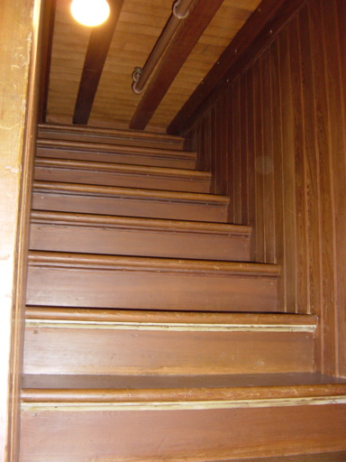

Slide 5
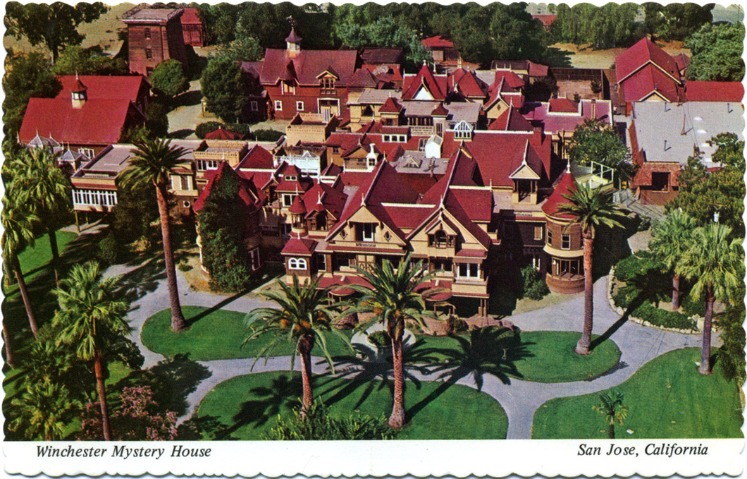

Slide 6
Objectives
Understand importance of extensibilityto software
Understand when and howMEF is used
Relation to other existing technologies
Your feedback

Slide 7
The Problem…
Software
Maintenance
Original Software
Development

Slide 8
Managed Extensibility Framework?
The Managed Extensibility Framework (MEF) is a new libraryin the .NET Framework that enables greater reuse of applications and components. Using MEF, .NET applications can make the shift from being statically compiled to dynamically composed

Slide 9

com·pose [ kəmpṓz ]
2) To put things together to form a whole
MSN Encarta

Slide 10
Open/Closed Principle
Software entities should be
open for extension,
but closed for modification.

Slide 11
Known
vs.
Unknown

Slide 12
MEF Basics…
An Application is built of parts.

Slide 13
MEF Basics…
Export it.
Import it.
Compose it.

Slide 14
Part, enter stage left…
public class SimpleMortgageCalculator : IMortgageCalculator
{
public ILogger Logger { get; set; }
public float Calculate()
{
Logger.Log("Calculating Mortgage");
return ...;
}
}
Part
A

Slide 15
Exportit…
[Export(typeof(IMortgageCalculator))]
public class SimpleMortgageCalculator : IMortgageCalculator
{
public ILogger Logger { get; set; }
public float Calculate()
{
Logger.Log("Calculating Mortgage");
return ...;
}
}
Part
A

Slide 16
Importit…
[Export(typeof(IMortgageCalculator))]
public class SimpleMortgageCalculator : IMortgageCalculator
{
[Import(typeof(ILogger))]
public ILogger Logger { get; set; }
public float Calculate()
{
Logger.Log("Calculating Mortgage");
return ...;
}
}
Part
A

Slide 17
Compose it.
Catalogs provide the parts.
Catalog

Slide 18
Compose it.
Containeris the matchmaker.
Catalog

Slide 19


Compose it.
AggregatingCatalog
Containeris the matchmaker.
DirectoryCatalog
Catalog
AssemblyCatalog
TypeCatalog

Slide 20


Step 1 – MEF Basics

Slide 21
Don’t forget the metadata…
[Export(typeof(IMortgageCalculator))]
[ExportMetadata(“Calculation”, “Simple”)]
[ExportMetadata(“Tax Aware”, null)]
public class SimpleMortgageCalculator : IMortgageCalculator
{
public ILogger Logger { get; set; }
public float Calculate()
{
Logger.Log("Calculating Mortgage");
return ...;
}
}
Part
A

Slide 22
Parts can be lazy…
[Import(typeof(ILogger))]
public ILogger Logger { get; set; }
Part
A
Part
B

Slide 23
Parts can be lazy…
[Import(typeof(ILogger))]
public ILoggerLazy<ILogger>Logger { get; set; }
Part
A
Lazy
<B>

Slide 24
Step 2 – Metadata and Lazy Evaluation

Slide 25
The slippery slope…
[Export(typeof(IMortgageCalculator))]
[ExportMetadata(“Calculation”, “Simple”)]
[ExportMetadata(“Tax Aware”, null)]
[ExportMetadata(“This”, “foo”)]
[ExportMetadata(“That”, “bar”)]
Part
A

Slide 26
The slippery slope… solved
[Export(typeof(IMortgageCalculator))]
[ExportMetadata(“Calculation”, “Simple”)]
[ExportMetadata(“Tax Aware”, null)]
[ExportMetadata(“This”, “foo”)]
[ExportMetadata(“That”, “bar”)]
[Export(typeof(IMortgageCalculator))]
[CalcCapabilities(
Mode=Complexity.Simple,
TaxAware=true,
This=“foo”,
That=“bar”)]
Part
A

Slide 27
Step 3 – Strongly-Typed Metadata

Slide 28
The importance of context!

Slide 29
Step 4 – Context Awareness

Slide 30
Lifetime
Shared
Non-Shared
Container
Container
Part A
Part B
Part B
Part B

Slide 31
Step 5 – Lifetime

Slide 32
But……
Where are the
so-called external dependencies?

Slide 33
.\Extensions
CompositionContainer

Slide 34
Step 6 – External Dependencies

Slide 35
The Power of Being Declarative
Whatvs. How

Slide 36
What about System.AddIn?

Slide 37
What about
IoC Containers?

Slide 38
What about
Hand-Rolled Plugins?

Slide 39
The Problem…
Software
Maintenance
Original Software
Development

Slide 40
The Solution…
Software
Maintenance
Original
Software
Development

Slide 41
Resources
http://mef.codeplex.com
Clean Code, Robert C. Martin
Working Effectively with Legacy Code,
Michael Feathers
Refactoring, Martin Fowler

